Slide 1

Space App Challenge #2: Go Canada
Team : Syed, Jivitesh, Sabareesh, Joshua, Vismay

Slide 2
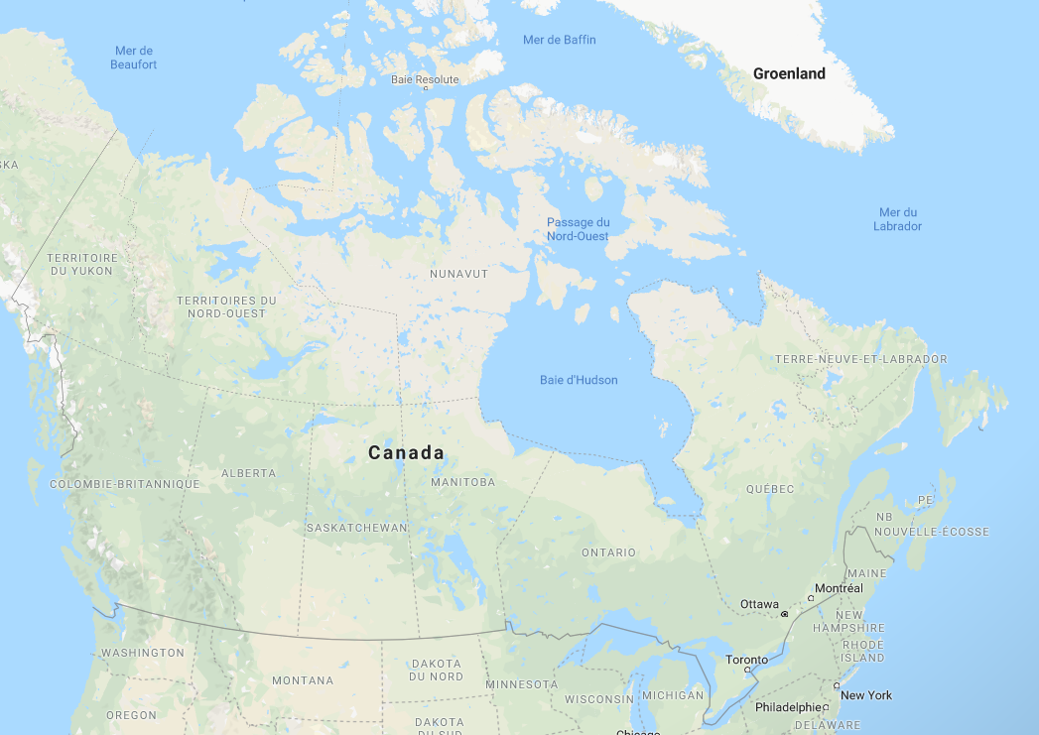
?
Go Canada
Challenge 2 – Data Sparsity
?
?
?

Slide 3
Why is magnetic field data important?
Navigation and surveying (GPS)
Electric power utilities and pipelines
Affects communication systems used in spacecrafts

Slide 4
Actionable Problem Statement
“How might we address the sparsity/discrepancy of magnetic field data across Canada in a cost-effective manner and accurate manner?

Slide 5
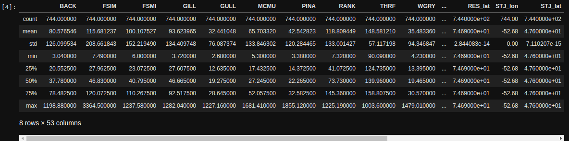
Dataset

Slide 6
Basis of our solution
Tobler’s 1st law of geography:
‘Everything is related to everything else, but near things are more related than distant things.’

Slide 7
Our approach
Use machine learning to fill in the empty data
Kriging:
Interpolation technique
Influence decreases with distance
Correlation using distance and direction (vs IDW)
Very good results for small datasets

Slide 8
Technical details
Data cleaning – txt to csv
Identify train and test datasets
Haversine distance
Rolling average of magnetic field variations

Slide 9
Our solution
Working prototype and not just an idea!
It’s a HACKATHON after all! ;)

Slide 10
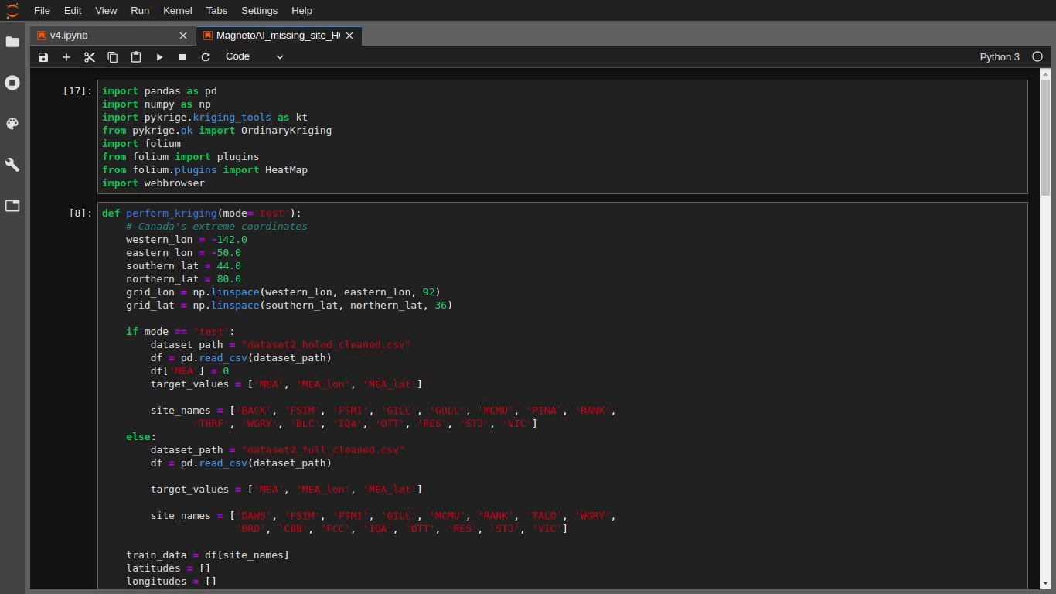
Demo

Slide 11
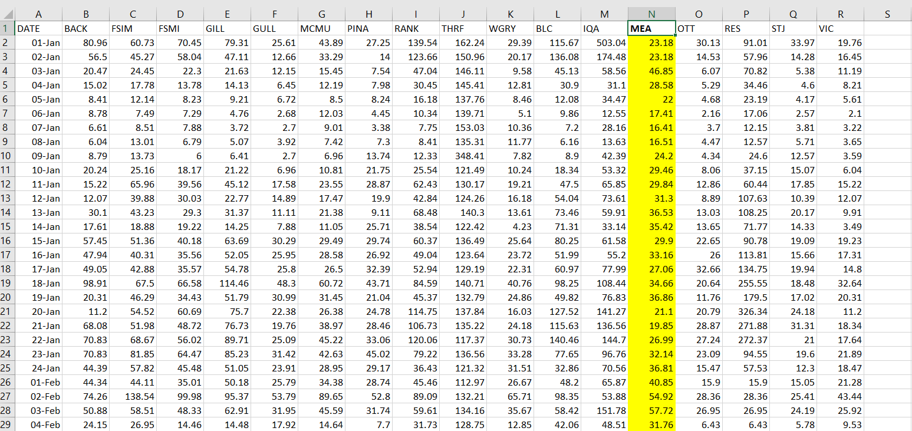
Results

Slide 12
Why our solution is very good
Translatable to other spatio-temporal interpolation problems
In short, we could have used the same exact technique to solve the other challenges related to sparsity/erroneous data

Slide 13
Business value
Very high accuracy
No extra cost
Translatable to other domains
Easy to use web interface

Slide 14
Thank you
Any Questions?

